Slide 1

Practice
Wenxuan Shi
College of Software, Nankai University
Email: shiwx@nankai.edu.cn
Wechat: 13920561100

Slide 2
Topics
Examples
Cookbook
Web Demos
Architecture

Slide 3
Examples
Notes:
StatelessWidget is used for immutable elements that only rely on the object configuration information
StatefulWidget is used for elements that can dynamically change based on state-changes in the system
Everytime that state changes, setChange() is called by the object

Slide 4
Topics
Add to App
Animations
Flutter Maps Firestore
Isolate Example
Jsonexample
Place Tracker
Platform Design
Platform View Swift
Provider Shopper

Slide 5
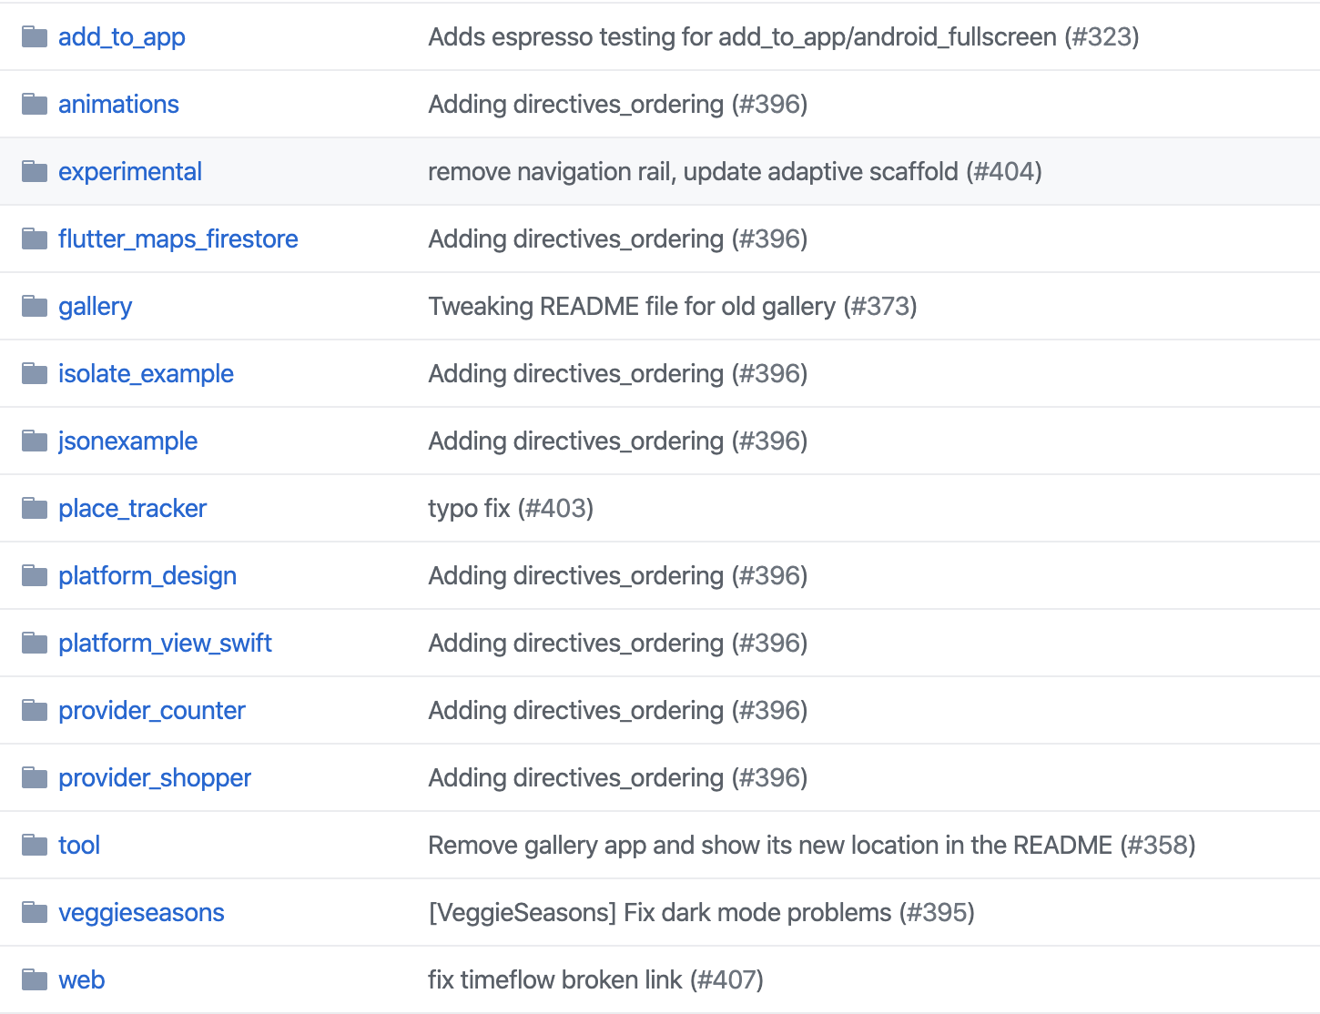
Introduction
See: https://github.com/flutter/samples
SourceCode: Samples-Flutter.zip

Slide 6
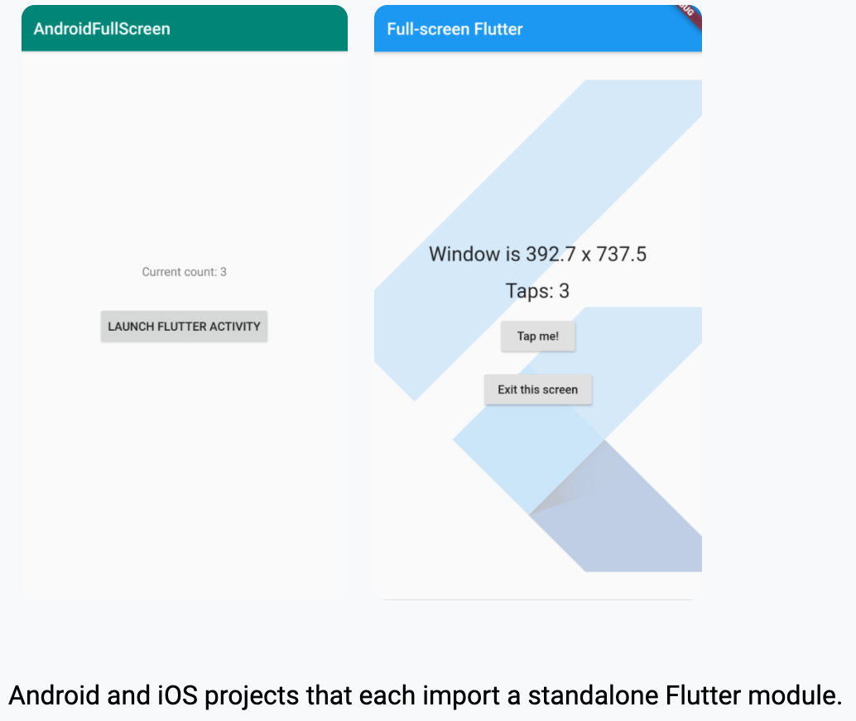
Add to App
This directory contains a bunch of Android and iOS projects that each import a standalone Flutter module.

Slide 7
Goals for this sample
Show developers how to add Flutter to their existing applications.
Show the following options:
Whether to build the Flutter module from source each time the app builds or rely on a separately pre-built module.
Whether plugins are needed by the Flutter module used in the app.

Slide 8
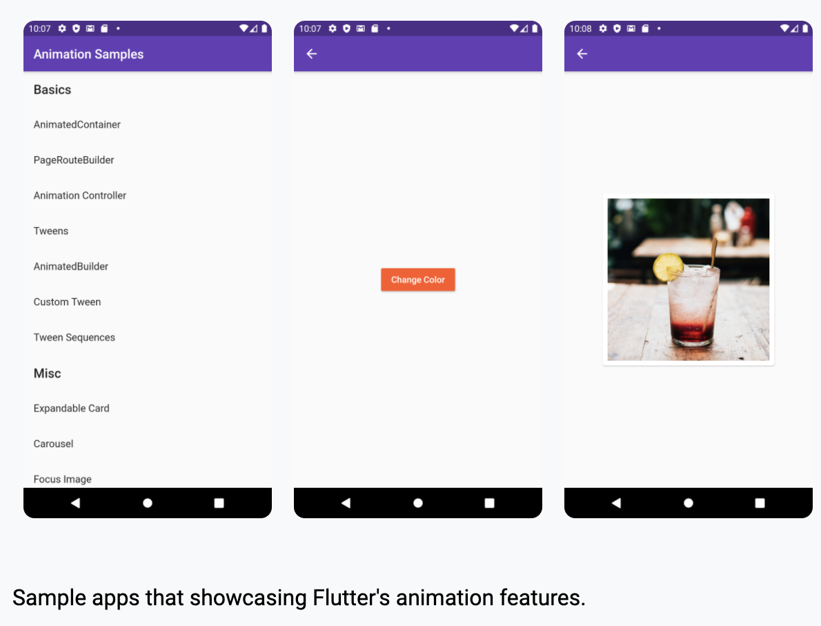
Animations
Sample apps that showcasing Flutter's animation features

Slide 9
Goals
Demonstrate the building blocks for animations and how they work together
Provide samples for common patterns and use-cases

Slide 10
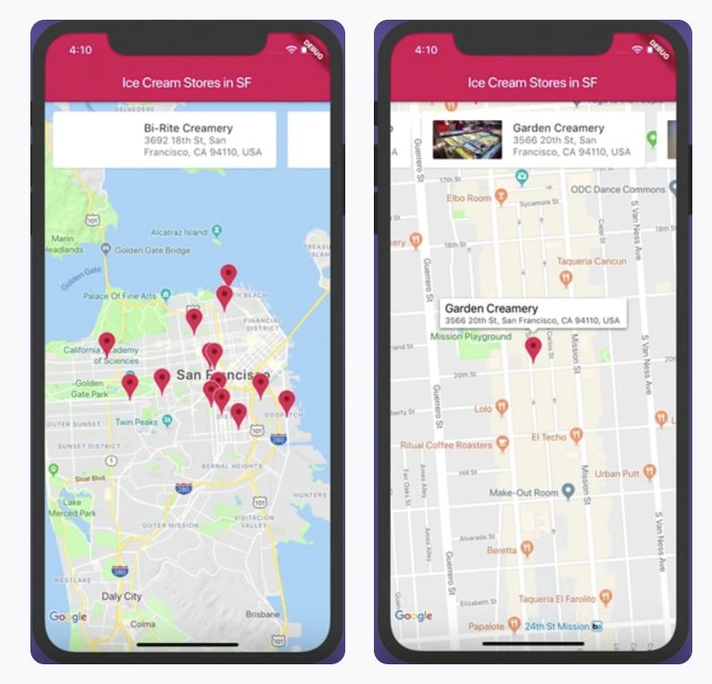
Flutter Maps Firestore
A Flutter sample app that shows the end product of the Cloud Next '19 talk Build Mobile Apps With Flutter and Google Maps. The live coding starts at about 17:40.

Slide 11
Goals for this sample
Showcase how to build an app that uses Google Maps with Flutter:
Loading a list of Ice Cream shops from Cloud Firestore
Listing the shops in a custom carousel
Showing the shop locations on a map using Markers
Controlling the Google Map from the carousel

Slide 12
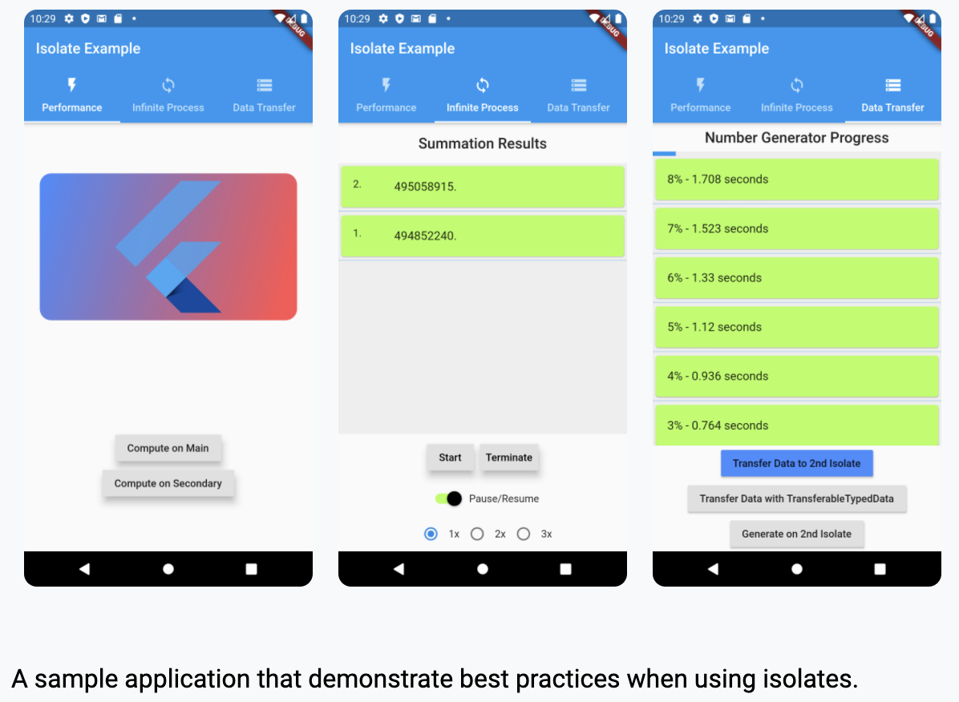
Isolate Example
A sample application that demonstrate best practices when using isolates.

Slide 13
Goals
Display the performance benefits of isolates when using them in the right situation.
Show how to use the compute method for straightforward computations.
Demonstrate how to initialize and use an isolate.
Show the cost of moving data between isolates and provide alternatives.

Slide 14
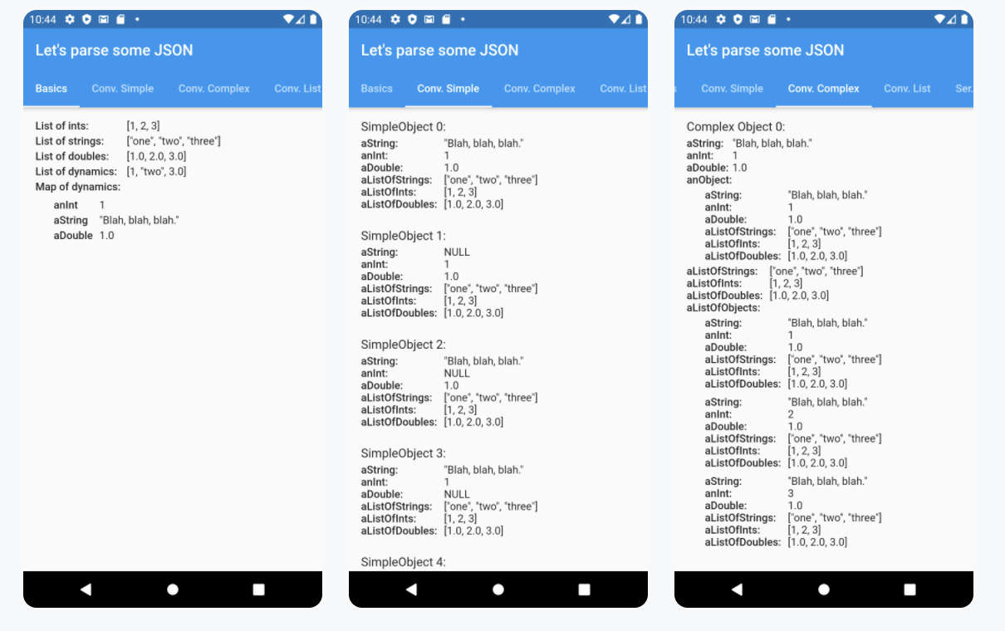
jsonexample
A Flutter sample app that deserializes a set of JSON strings using three different libraries: dart:convert, json_serializable, and built_value.

Slide 15
Goals for this sample
Help you decide which of the three most common libraries for deserializing JSON is right for your project.
Provide you with example code for deserializing:
Simple and nested objects
Lists of primitive values
Maps containing primitive values

Slide 16
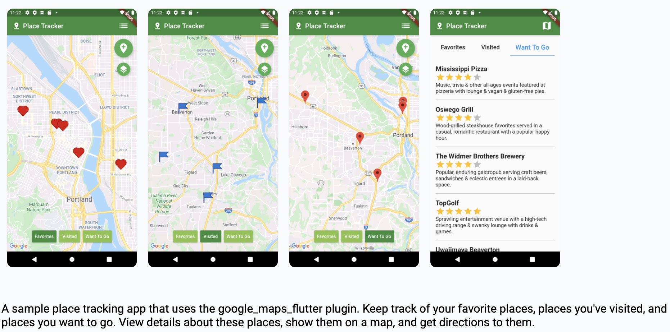
Place Tracker
A sample place tracking app that uses the google_maps_flutter plugin.

Slide 17
Goals
Learn how to create an interface composed of GoogleMap and other widgets.
Learn how to show, control, and modify a GoogleMap widget.
Learn how to place a marker on a map.

Slide 18
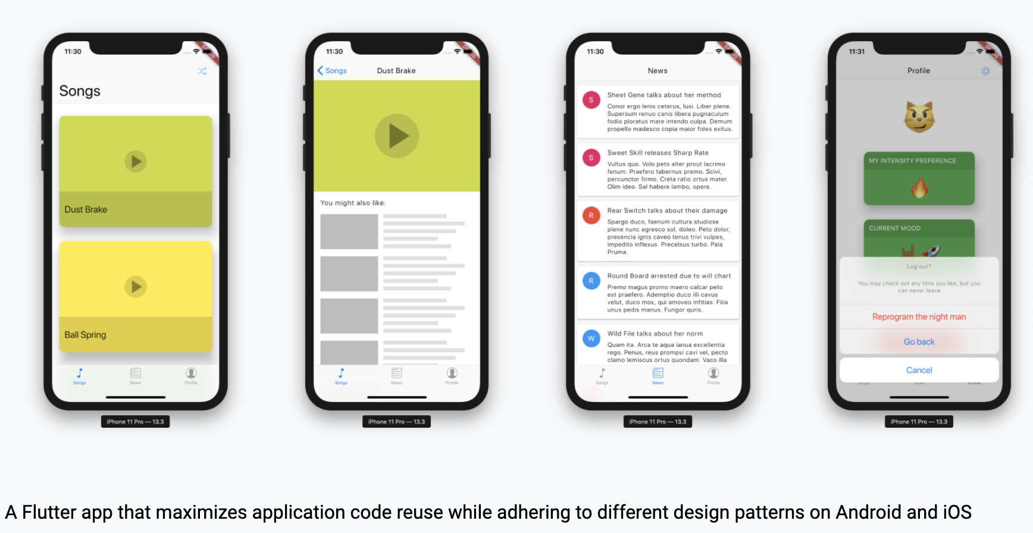
Platform Design
This sample project shows a Flutter app that maximizes application code reuse while adhering to different design patterns on Android and iOS.

Slide 19
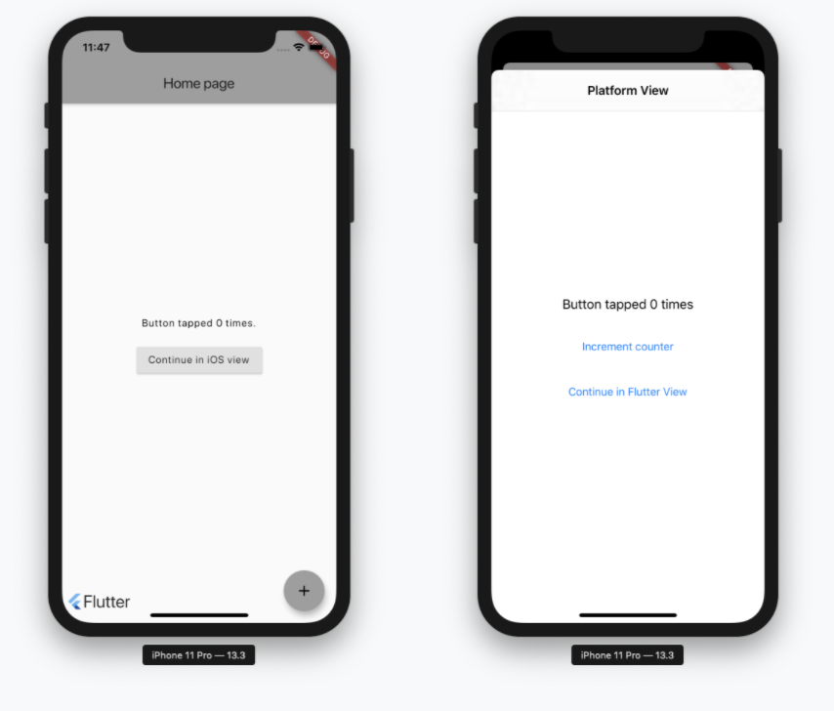
Platform View Swift
A Flutter sample app that combines a native iOS UIViewController with a full-screen Flutter view.
Goals for this sample
Show a simple technique for combining native and Flutter views.

Slide 20
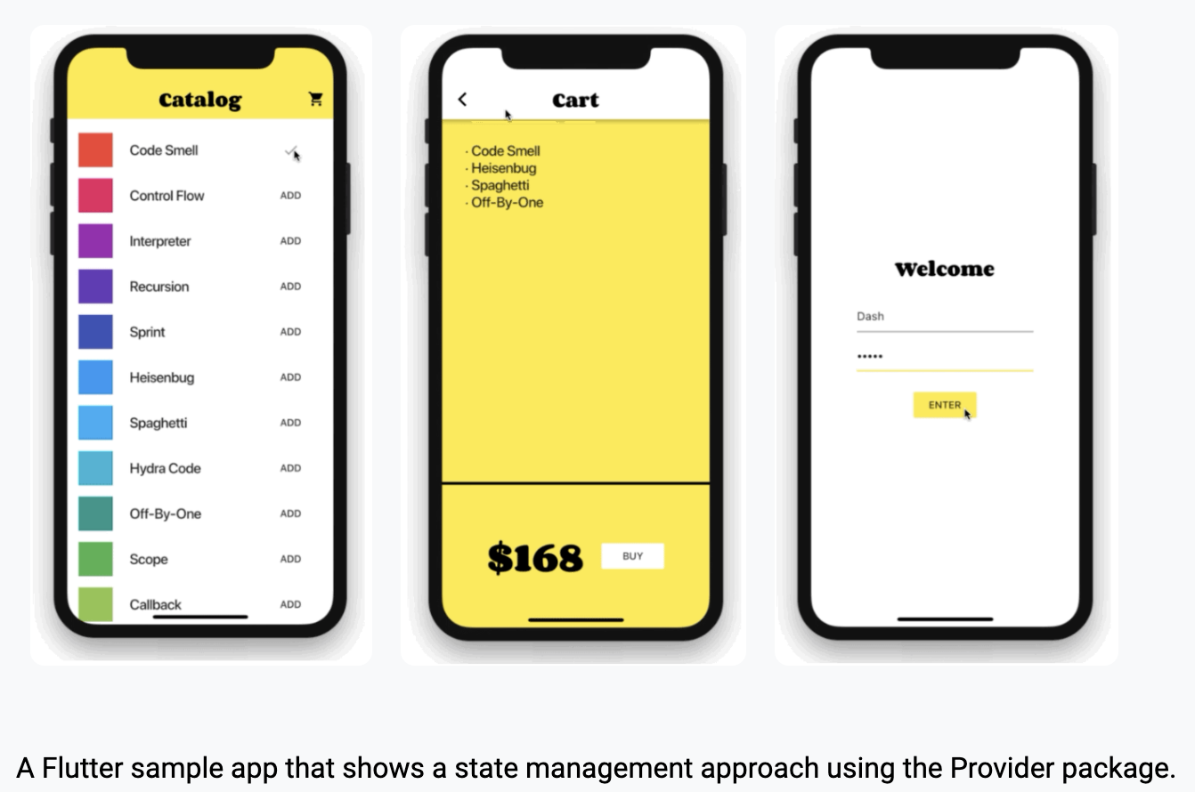
Provider Shopper
A Flutter sample app that shows a state management approach using the Provider package.

Slide 21
Goals for this sample
Show simple use of Provider for providing an immutable value to a subtree
Illustrate a simple state management approach using the ChangeNotifier class
Show use of ProxyProvider for provided objects that depend on other provided objects

Slide 22
Cookbook
Notes:
StatelessWidget is used for immutable elements that only rely on the object configuration information
StatefulWidget is used for elements that can dynamically change based on state-changes in the system
Everytime that state changes, setChange() is called by the object

Slide 23
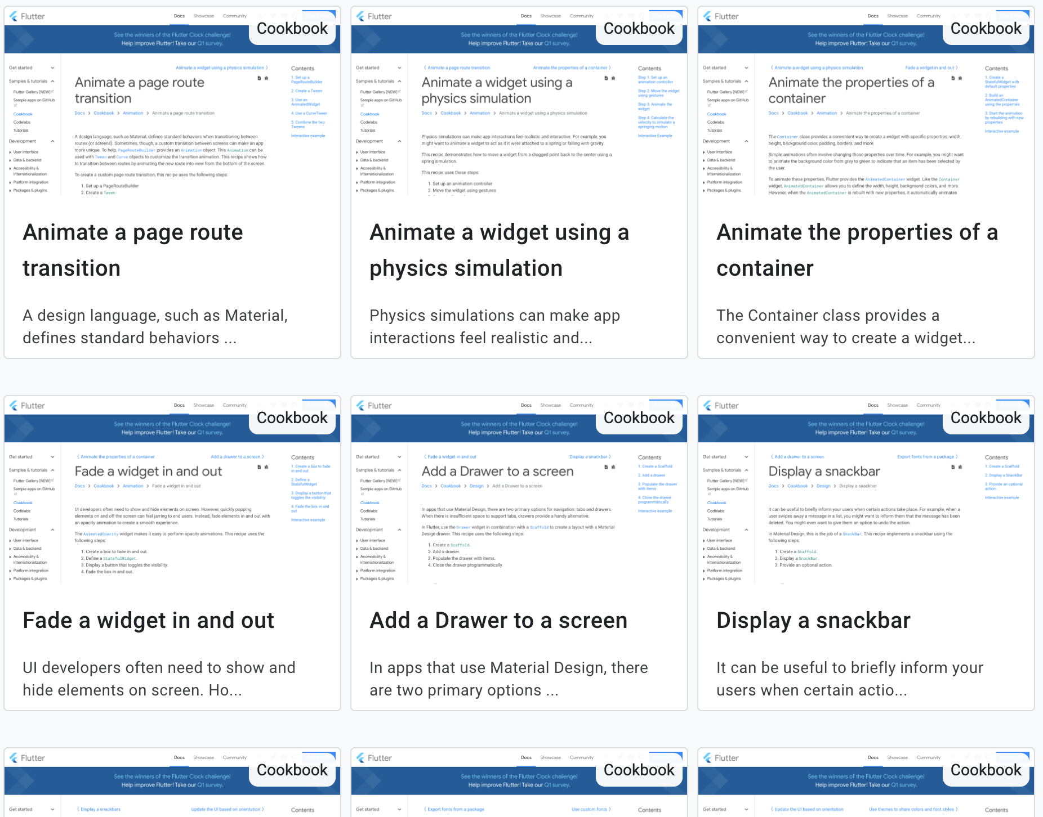
Introduction
Docs: https://flutter.dev/docs/cookbook
Source Code: https://flutter.github.io/samples/#?type=cookbook

Slide 24
Web Demos
Notes:
StatelessWidget is used for immutable elements that only rely on the object configuration information
StatefulWidget is used for elements that can dynamically change based on state-changes in the system
Everytime that state changes, setChange() is called by the object

Slide 25
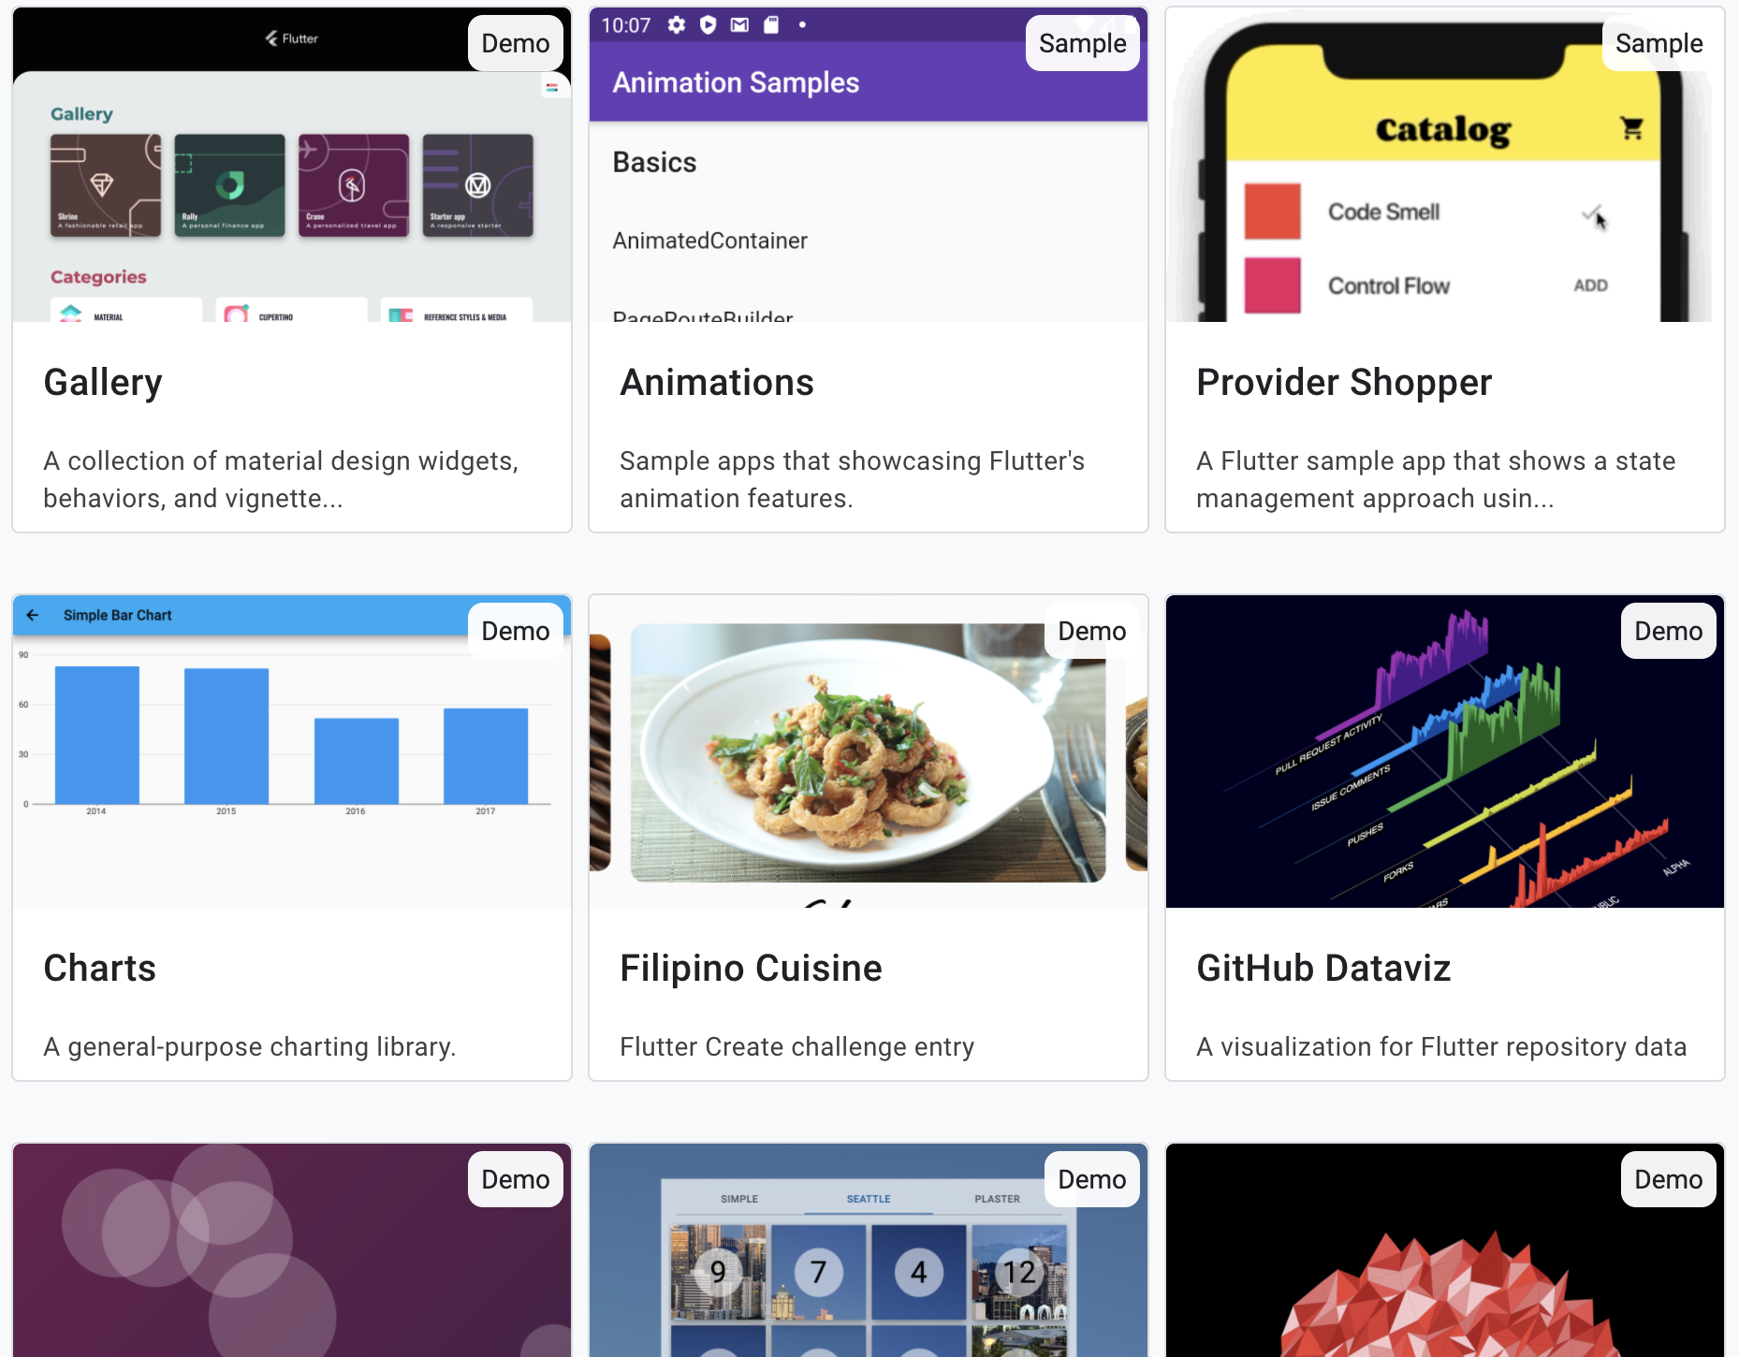
Introduction
Demos: https://flutter.github.io/samples/#?platform=web
Source Code: https://github.com/flutter/samples/tree/master/web

Slide 26
Architecture
Notes:
StatelessWidget is used for immutable elements that only rely on the object configuration information
StatefulWidget is used for elements that can dynamically change based on state-changes in the system
Everytime that state changes, setChange() is called by the object

Slide 27
Flutter architectural overview
The layer model: The pieces from which Flutter is constructed.
Reactive user interfaces: A core concept for Flutter user interface development.
An introduction to widgets: The fundamental building blocks of Flutter user interfaces.
The rendering process: How Flutter turns UI code into pixels.
An overview of the platform embedders: The code that lets mobile and desktop OSes execute Flutter apps.
Integrating Flutter with other code: Information about different techniques available to Flutter apps.
Support for the web: Concluding remarks about the characteristics of Flutter in a browser environment.

Slide 28
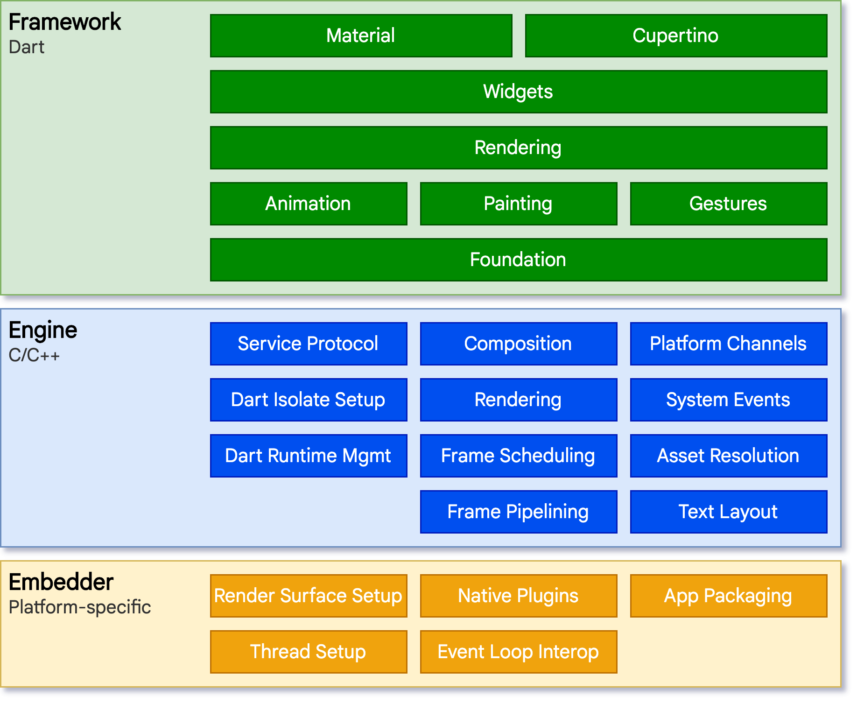
Architectural layers
Flutter is designed as an extensible, layered system.
It exists as a series of independent libraries that each depend on the underlying layer.

Slide 29
Reactive user interfaces
On the surface, Flutter is a reactive, pseudo-declarative UI framework.
The developer provides a mapping from application state to interface state
The framework takes on the task of updating the interface at runtime when the application state changes.

Slide 30
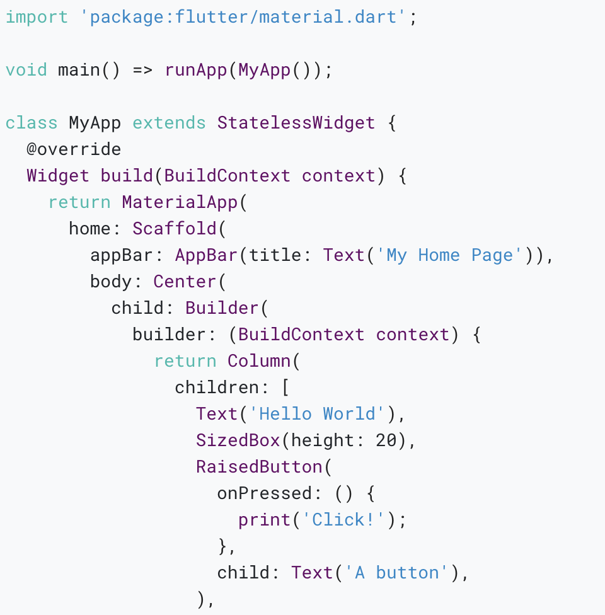
Widgets
As mentioned, Flutter emphasizes widgets as a unit of composition.
Widgets are the building blocks of a Flutter app’s user interface, and each widget is an immutable declaration of part of the user interface.

Slide 31
Composition
Widgets are typically composed of many other small, single-purpose widgets that combine to produce powerful effects.
Where possible, the number of design concepts is kept to a minimum while allowing the total vocabulary to be large.
Building widgets
You can determine the visual representation of a widget by overriding the build() function to return a new element tree.

Slide 32
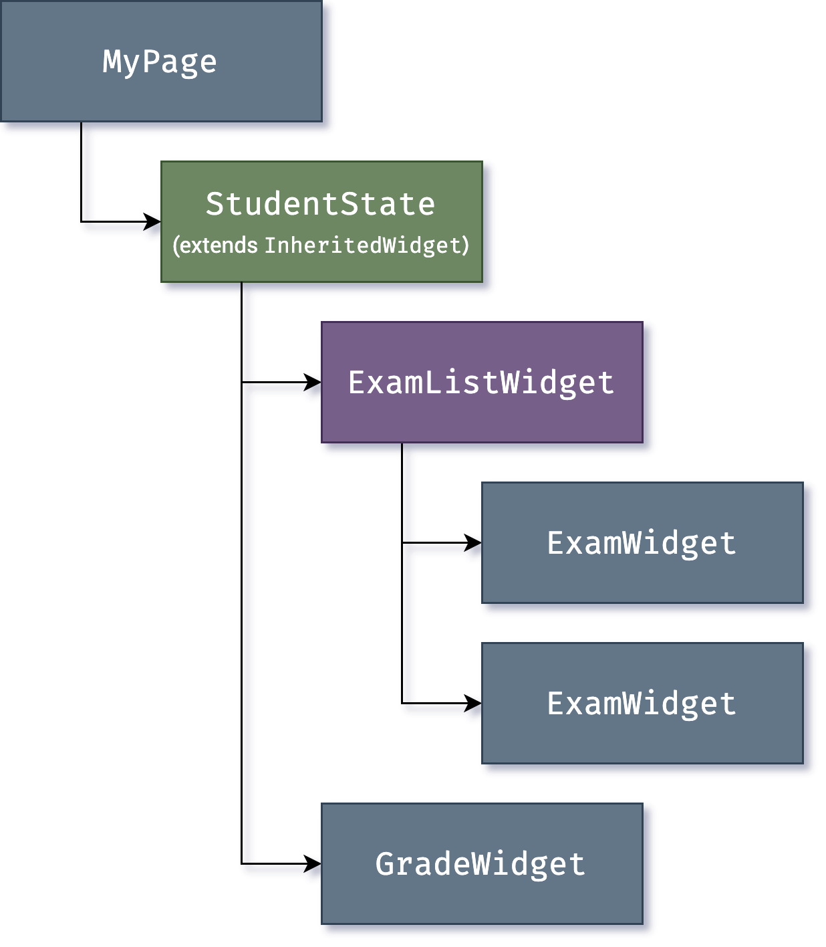
Widget state
The framework introduces two major classes of widget: stateful and stateless widgets.
State management
You can use InheritedWidget to create a state widget that wraps a common ancestor in the widget tree.

Slide 33
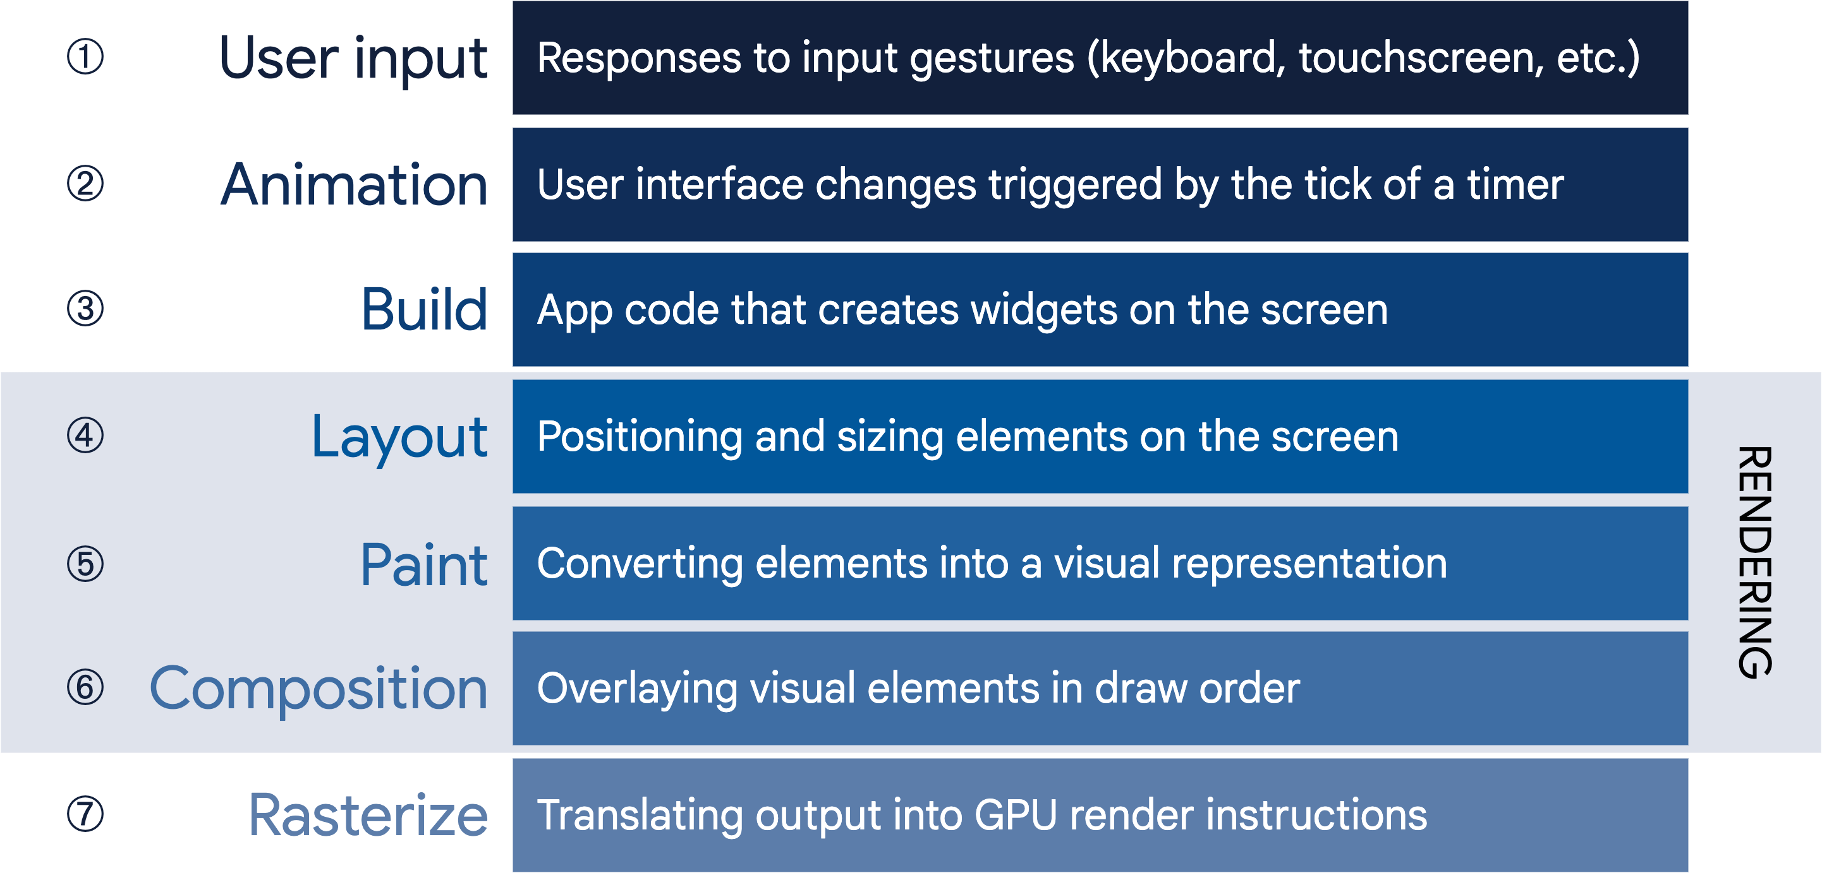
Rendering and layout
From user input to the GPU

Slide 34
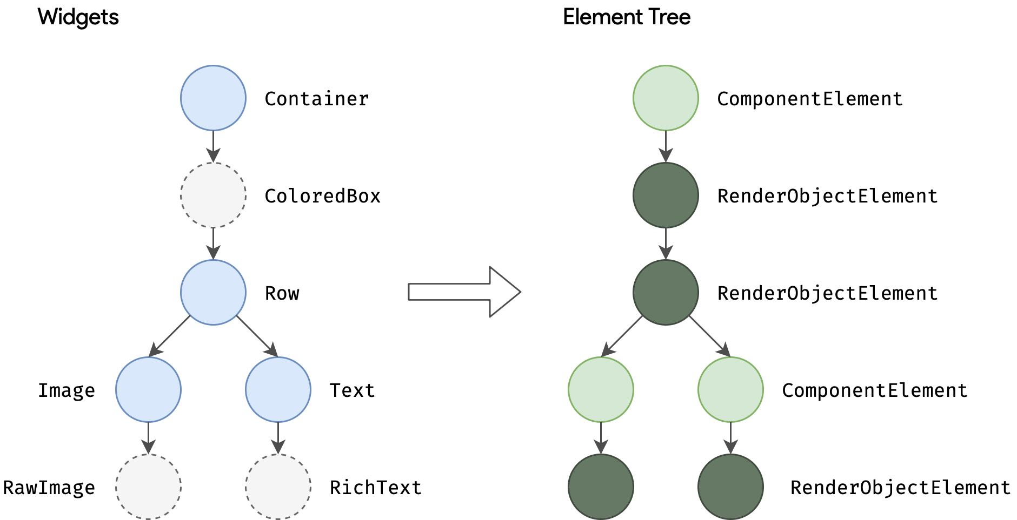
Build: from Widget to Element

Slide 35
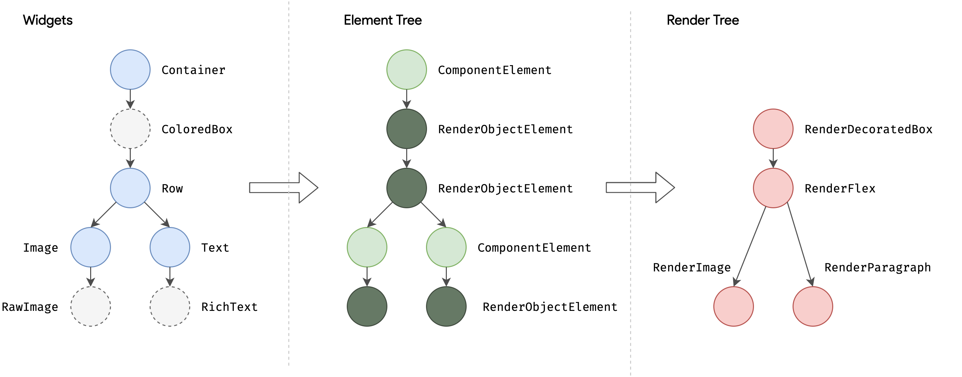
Layout and rendering

Slide 36
Platform embedding
As we’ve seen, rather than being translated into the equivalent OS widgets, Flutter user interfaces are built, laid out, composited, and painted by Flutter itself.
The platform embedder is the native OS application that hosts all Flutter content, and acts as the glue between the host operating system and Flutter.

Slide 37
Integrating with other code
Flutter provides a variety of interoperability mechanisms, whether you’re accessing code or APIs written in a language like Kotlin or Swift, calling a native C-based API, embedding native controls in a Flutter app, or embedding Flutter in an existing application.

Slide 38
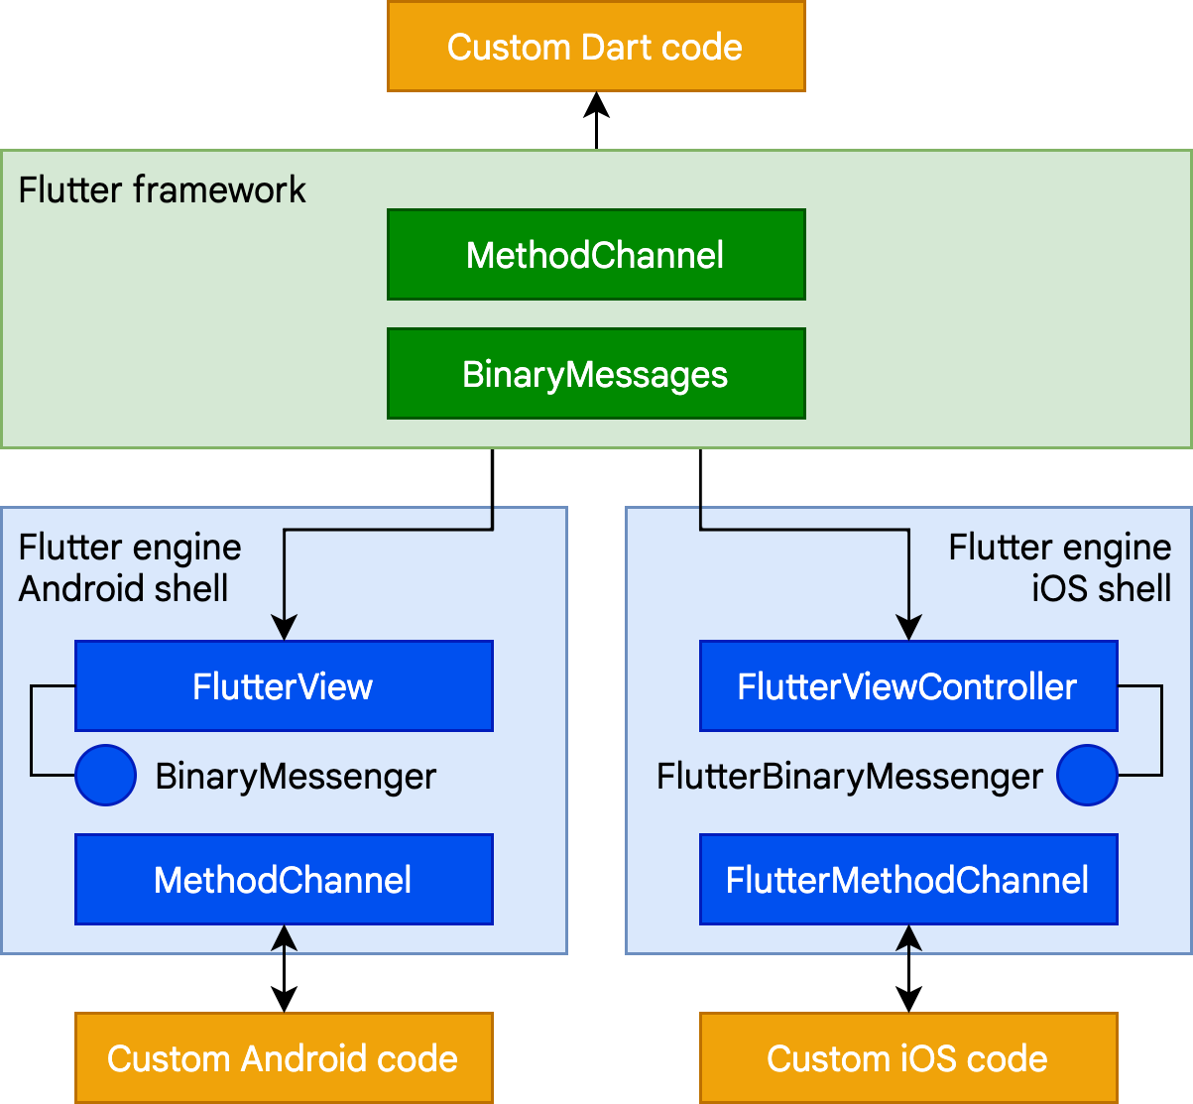
Platform channels
For mobile and desktop apps, Flutter allows you to call into custom code through a platform channel, which is a simple mechanism for communicating between your Dart code and the platform-specific code of your host app.

Slide 39
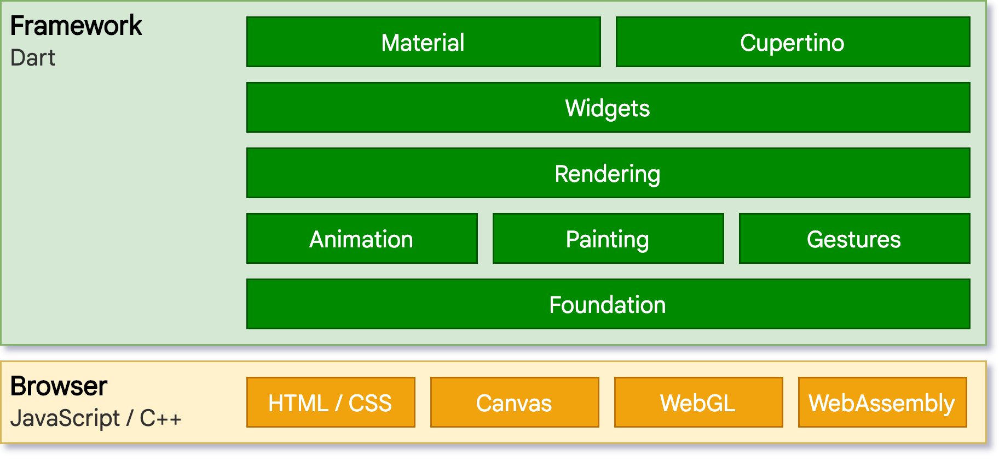
Flutter web support
The web version of the architectural layer diagram is as follows:

Slide 40
Thank you!
Wenxuan Shi
College of Software, Nankai University
Email: shiwx@nankai.edu.cn
Wechat: 13920561100

